Slide 1
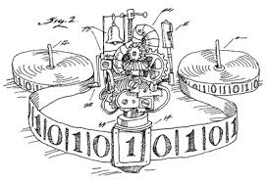
Theory of Computing
Sauda Adiv Hanum
Assistant Lecturer,
Dept. of CSE, IIUC

Slide 2
What is Theory of Computing or Computation?
Computation is the movement & alteration which occurs during the transition of data or the processing of data based on a set of operations.
The theory of computation includes the fundamental mathematical properties of computer hardware, software & their applications.
It is a computer science branch which deals with how a problem can be solved efficiently by using an algorithm on a model of computation.

Slide 3
What is Theory of Computing or Computation?
Theory of Computation is a branch of computer science & Mathematics that focuses on the logic of computation
how different problems are solved using algorithms and the efficiency of the solutions.
It is a scientific control concerned with the investigation of computing features such as natural, artificial, and otherwise fictitious.
Most importantly, it intends to become acquainted with the atmosphere of resourceful computation.

Slide 4
What is Automata Theory?
Study of abstract computing devices, or “machines”
Automaton = an abstract computing device
Note: A “device” need not even be a physical hardware!
A fundamental question in computer science:
Find out what different models of machines can do and cannot do
The theory of computation
Computability vs. Complexity

Slide 5
Why?
When developing solutions to real problems, we often confront the limitations of what software can do.
Undecidable things – no program whatever can do it.
Intractable things – there are programs, but no fast programs.
CSE331 gives you the tools.

Slide 6
Why?
We’ll learn how to deal formally with discrete systems.
Proofs: You never really prove a program correct, but you need to be thinking of why a tricky technique really works.
We’ll gain experience with abstract models and constructions.
Models layered software architectures.

Slide 7
Why?
To better understand the development of formal mathematical models of computation that reflect the real-world of computer.
To achieve deep understanding about the mathematical properties of computer hardware and software

Slide 8
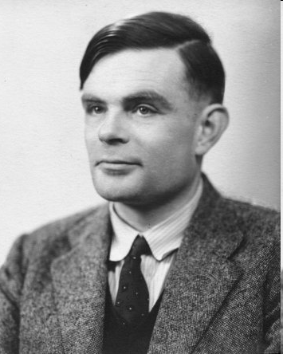
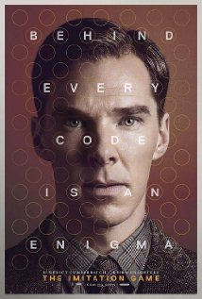
Alan Turing (1912-1954)
(A pioneer of automata theory)
Father of Modern Computer Science
English mathematician
Studied abstract machines called Turing machines even before computers existed
Heard of the Turing test?

Slide 9
Theory of Computation: A Historical Perspective
Alan Turing studies Turing machines
Decidability
Halting problem
1930s
“Finite automata” machines studied
Noam Chomsky proposes the “Chomsky Hierarchy” for formal languages
1940-1950s
Cook introduces “intractable” problems or “NP-Hard” problems
what could and what could not be computed
1969
Modern computer science: compilers, computational & complexity theory evolve
1970-

Slide 10
Types of Computation
Automata Theory
Formal Language
Computability theory
Complexity theory.

Slide 11
Automata Theory
It deals with the definition & properties of various mathematical models of computers.
Automata are machines that accept a string as input & process it through a finite number of states before reaching the end state.
The primary objective for creating automata theory was to create tools for describing & analysing the dynamic behaviour of discrete systems.

Slide 12
Automata Theory
Finite Automata (FA)
Finite State Machine (FSM), is a simple machine that is able to recognize patterns.
It is an abstract machine with five components or tuples.
It contains a set of states & rules for going from one state to the next, but it is dependent on the input symbol used.
It is essentially an abstract representation of a digital computer.
Applications: compilers, hardware design and text processing
Finite automata has two states: Accept State or Reject State.
02 Types of FA: NFA and DFA

Slide 13
Formal Language Theory
Formal Language Theory is a branch of Computer Science and Mathematics dealing with representing languages as a collection of operations on an alphabet.
It was first initiated by Noam Chomsky in the 1950s.
Formal language studies is concerned
syntax of languages
their internal structural patterns.
Due to the rise of linguistics in the field of formal language, the syntactic regularities of natural languages now have a means for comprehension.

Slide 14
Applications:
define the programming languages
Natural language
3 types
Context-free languages
Context-sensitive languages
Regular languages

Slide 15
Computability Theory
Computability theory deals with what can and cannot be computed by the model.
The theoretical models are proposed in order to understand the solvable and unsolvable problems which lead to the development of the real computers.
Turing machine − These are simple abstract models of a real computer.

Slide 16
Computational Complexity Theory
Classifies computational problems according to their resource usage.
Complexity theory groups the computable problems based on their hardness.
For example,
Any problem is easy, if it is solved efficiently.
sorting sequence, searching name.
Any problem is hard, if it cannot be solved efficiently.
factoring a 500-digit integer into its prime factor.
The main purpose of theory of computation is to develop a formal mathematical model of computation that reflects the real world computers.

Slide 17
Advantages of Using ToC
ToC deals with how efficiently any algorithm would solve any computational problem.
Also, abstract machines are introduced in the Computational theory, which are defined mathematically.
Hence, the algorithms would not need to change every time any physical hardware gets enhanced.
There is a massive amount of work that has been made possible in the portion of NLP (Natural Language Processing) that involves the construction of FSMs (Finite State Machines), also known as FSA (Finite State Automata).

Slide 18
Theory of Computation has helped in many fields such as Cryptography, Design & Analysis of Algorithm, Quantum Calculation, Logic within Computer Science, Computational Difficulty, Randomness within Calculation and Correcting Errors in Codes
A computational model can cope with complexity in ways that verbal arguments cannot, resulting in satisfactory answers for what would otherwise be ambiguous hand-wavy arguments.
Furthermore, computational models can manage complexity at several levels of analysis, allowing data from various levels to be integrated and connected.

Slide 19
Theory of Computation & Automata are simple subjects of CSE that attempt a deep understanding of computational problems and analysis.
It makes us understand the establishment of formal mathematical models of computing that mirror the computer's real-world.
It also helps us to understand different algorithms, hardwares and softwares.
Hence it is one of the most essential & core areas to study for computer engineers or aspirants.

Slide 20
Applications of ToC
Game of Life: The most popular application of merging of Automata Theory (Theory of Computation) & Biology
Complexities in Natural Selection in Biology can be modeled using Automata Theory (Theory of Computation)
Entire Universe can be modeled with a Automata Machine in Theory of Computation and is similar to existing theories in Physics
Deterministic Finite Automata (DFA) is used in Compiler Design where the first step is lexer (lexical analysis)
Models in Theory of Computation are used to model real life Computing Machines and Problems.
Models in Theory of Computation can be used to find limitation of Computing Machines like Halting Problem.
Super Recursive Algorithms in Theory of Computation present the future of Computing Devices.

Slide 21
Other real life applications of DFA:
Traffic Lights
Video Games
CPU Controllers
Protocol Analysis
Regular Expression Matching
Vending Machines
Speech Recognition
Natural Language Processing
Auto-complete search in Apache Lucene uses Finite State Transducer (FST) (extension of DFA)
DFAs for simple Artificial Intelligence applications.
DFAs with probabilistic transitions are known as Markov Chain.
All Algorithms are designed using Turing Machine.

Slide 22
Vending Machines using ToC
Vending Machines are machines installed in a city on the side of roads at specific intervals.
Citizens can insert money into these machines & get the selected drinks/snacks automatically and the return change was provided by the machine as well.
Such machines are very popular in Japan.
Can be designed using Deterministic Finite Automata (DFA)

Slide 23
The states of DFA for Vending Machines:
Q = {$0.00, $0.25, $0.50, $0.75, $1.00, $1.25, $1.50, $1.75, $2.00} (states)
Σ = {$0.25, $1.00, select} is the alphabet
q₀ = $0.00 is the start state
F = ∅ is the set of accept states
The transition function is defined by the state diagram.

Slide 24
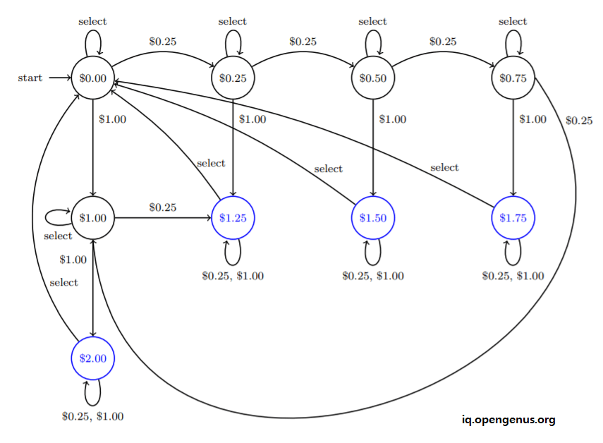
State diagram of Vending Machine

Slide 25
https://www.youtube.com/watch?v=SV57Yv8BXBc
Why Study ToC

